Slide 1
Dispensation Module v2.1 26 March 2022

Slide 2
Dispensation
Features:
Add details of the product and quantity of drugs issued to patients
Print and download the details of drug dispensed in a pdf form and share with patients
Save time spent in repetitive data entry by copying previous dispensation details.
Log details of drugs that are returned by patients.
Ensure timely dispensation of drugs to patients by accessing list of patients whose refill is due through the ‘Refill Due Task List’
Outcome Validations & Adherence Linkages:
Auto Extension of End Date if the “Next Refill Due Date’ is greater than the Treatment End Date.
Adherence-Dispensation correlation restricts manual doses from being added if no active dispensation is available.
Adherence-Dispensation correlation is defaulted to ‘Yes’ for DSTB patients and ‘No’ for DRTB Patients with the ability to switch on or off as required.

Slide 3
Contents
Reason why Prescription Module is getting replaced with Dispensation Module
Navigation to Dispensation module
Add Dispensation
Print Dispensation
Return Dispensation
Copy Dispensation
Refill Due Task-list
Outcome Assignment Changes
Adherence Dispensation Correlation

Slide 4
Prescription Module replaced with Dispensation Module
We are replacing the Prescription module with the new “Dispensation” module for following reasons:
The fields that were part of the current Prescription module was not always relevant
No linkage to when Drug Refills were due for patients
No option to Print and Copy Products from previous prescriptions
No differentiation between when the drugs were prescribed, when the drugs were provided and when the dosage starts
No option to return the drugs issued to patients
No Linkage between Drugs Prescribed to Adherence
This module will be available for all patients in the following stages:
On Treatment
Outcome Assigned

Slide 5
Workflow for Add Dispensation

Slide 6
Workflow for Return Dispensation

Slide 7
How to navigate to Dispensation Module
Step 1
Click on ‘Add Dispensation’ Button
Click here for Dispensation Module

Slide 8
How to navigate to Dispensation Module
Step 1
Step 2
Click on ‘Add Dispensation’ Button
Search by Episode ID or Dispensation ID
Search can also be initiated with the Dispensation ID
Enter the Episode ID to initiate the search on any Patient’s details
Dispensation Details can also be added from the Patient Page
Click here to
Start the search

Slide 9
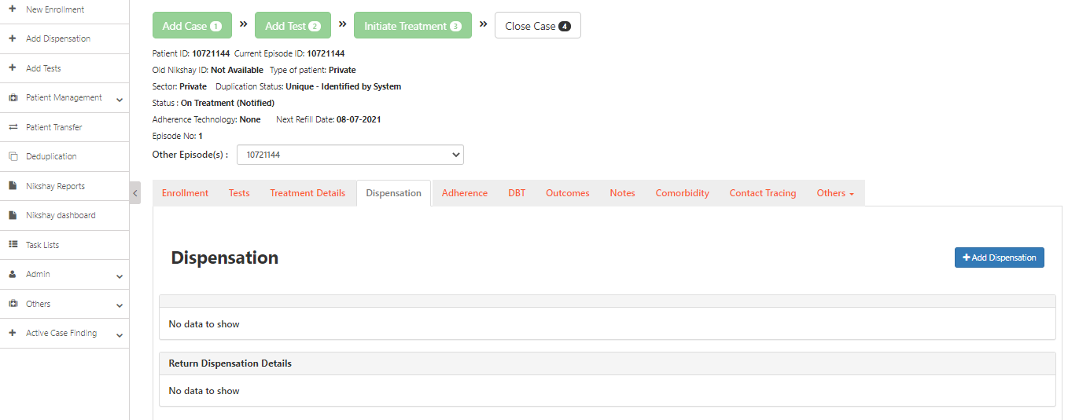
Add Dispensation
Step 1
Step 1
Step 1
Click on Dispensation Tab
Click here to add Dispensations

Slide 10
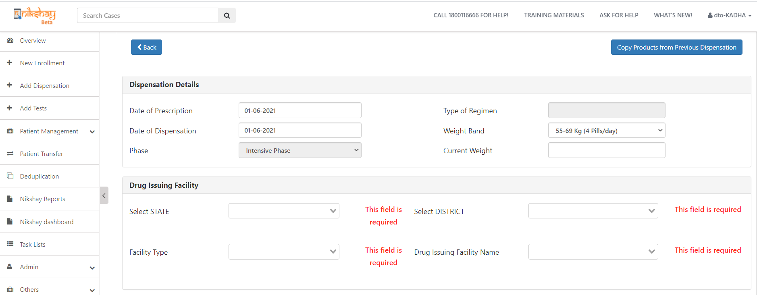
Add Dispensation
Step 1
Step 1
Step 2
Step 1
Click on Dispensation
Enter Dispensation Details
Enter the “Date of Prescription”
Type of Regimen gets auto-populated based on the Test Results
Enter the “Date of Dispensation”
“Weight Band” is getting auto-populated based on the patients’ primary data
Click here to copy medicine / products from the previous Dispensation
1
2
3
4
5. Phase also gets auto-populated based on the Test Results
6. Enter the “Current Weight”

Slide 11
Add Dispensation
Step 1
Step 2
Step 3
Step 1
Step 1
Click on Dispensation
Enter Dispensation Details
Enter Drug Issuing Facility Details
The weight band is auto populated and is editable with the other weight band options available in the dropdown
7. Select the State
8. Select the District
10. Select the “Drug Issuing Facility Name” from the drop down option
9. Select the “Drug Issuing Facility Type” from these three options

Slide 12
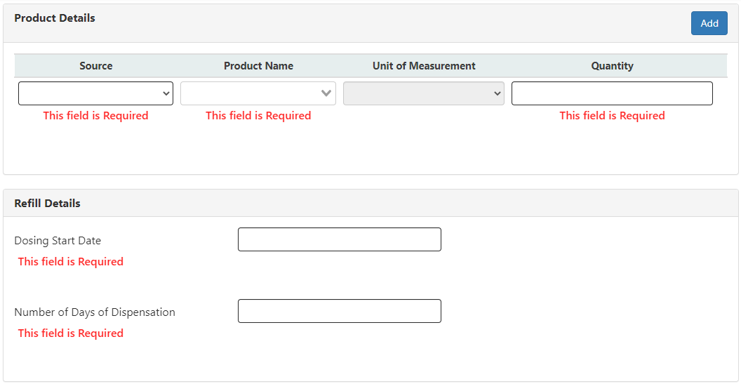
Add Dispensation
Step 1
Step 2
Step 3
Step 4
Step 1
Step 1
Click on Dispensation
Enter Dispensation Details
Enter Drug Issuing Facility Details
Enter Product Details
1
*2
3
4
5
Click on “Add” if required to add more product(s)
Select the “Source” from the list
Select the prescribed product name from the drop down option, it is a mandatory field.
It is an auto-populated field based on the chosen product
Enter the “Quantity” as per the prescription, it is a mandatory field.

Slide 13
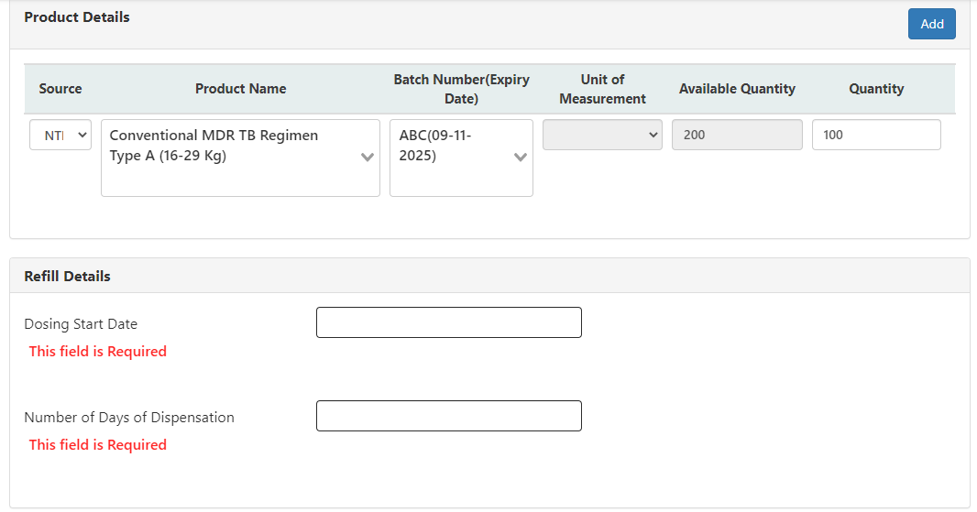
Add Dispensation- NTEP Product addition
Step 1
Step 2
Step 3
Step 4
Step 1
Step 1
Click on Dispensation
Enter Dispensation Details
Enter Drug Issuing Facility Details
Enter Product Details
1
2
3
4
5
6
Click on “Add” if required to add more product(s)
Selected the “Source” as NTEP from the list
Select the prescribed product name from the drop down option, it is a mandatory field.
Select the batch number from the drop down option, it is a mandatory field.
The Available quantity of the product is shown as a display only field
Select the quantity less than or equal to the available quantity.
Please Note- Products with zero quantities would not get listed in the “Product name” dropdown

Slide 14
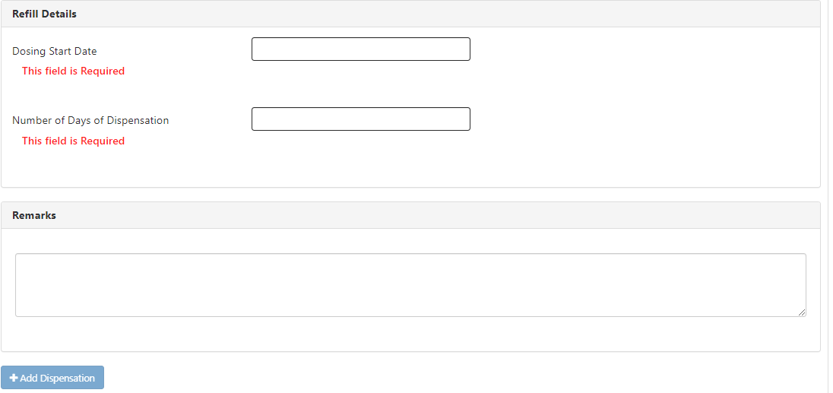
Add Dispensation
Step 1
Step 2
Step 3
Step 4
Step 1
Step 1
Step 5
Click on Dispensation
Enter Dispensation Details
Enter Drug Issuing Facility Details
Enter Product Details
Enter Refill Details
Enter the dosing start date as per the prescription, it is a mandatory field
Enter number of days of dispensation as per the prescription, it is a mandatory field
Enter remarks, if any
10. Click here to add the dispensation
Note: If the Facility type is selected as ‘PHI’ then only ‘NTEP’ option is visible in the ‘Source’ field. If ‘Chemist’ or ‘Private HF’ are selected both ‘NTEP’ and ‘Private’ will be visible in the source.

Slide 15
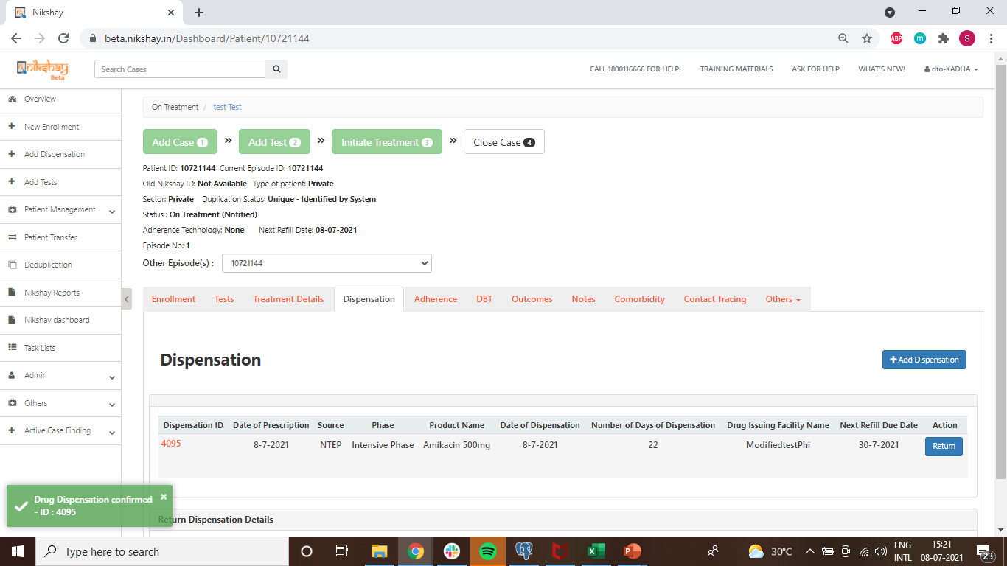
Add Dispensation
Details of the Dispensation added are displayed here.
This message pops up after successful addition of a dispensation

Slide 16
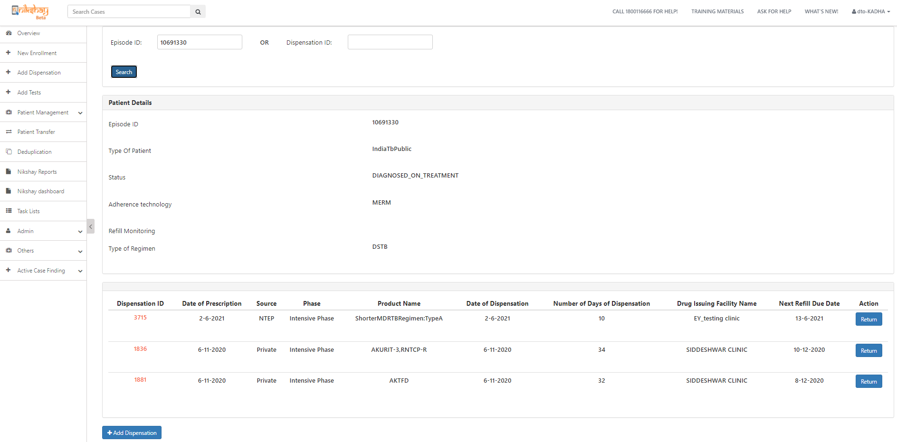
Print Dispensation Details
Dispensation details can be viewed/added by entering the Episode or Dispensation ID of the patients
Click on the Dispensation ID to view the dispensation details and to a print a copy of the selected dispensation.

Slide 17
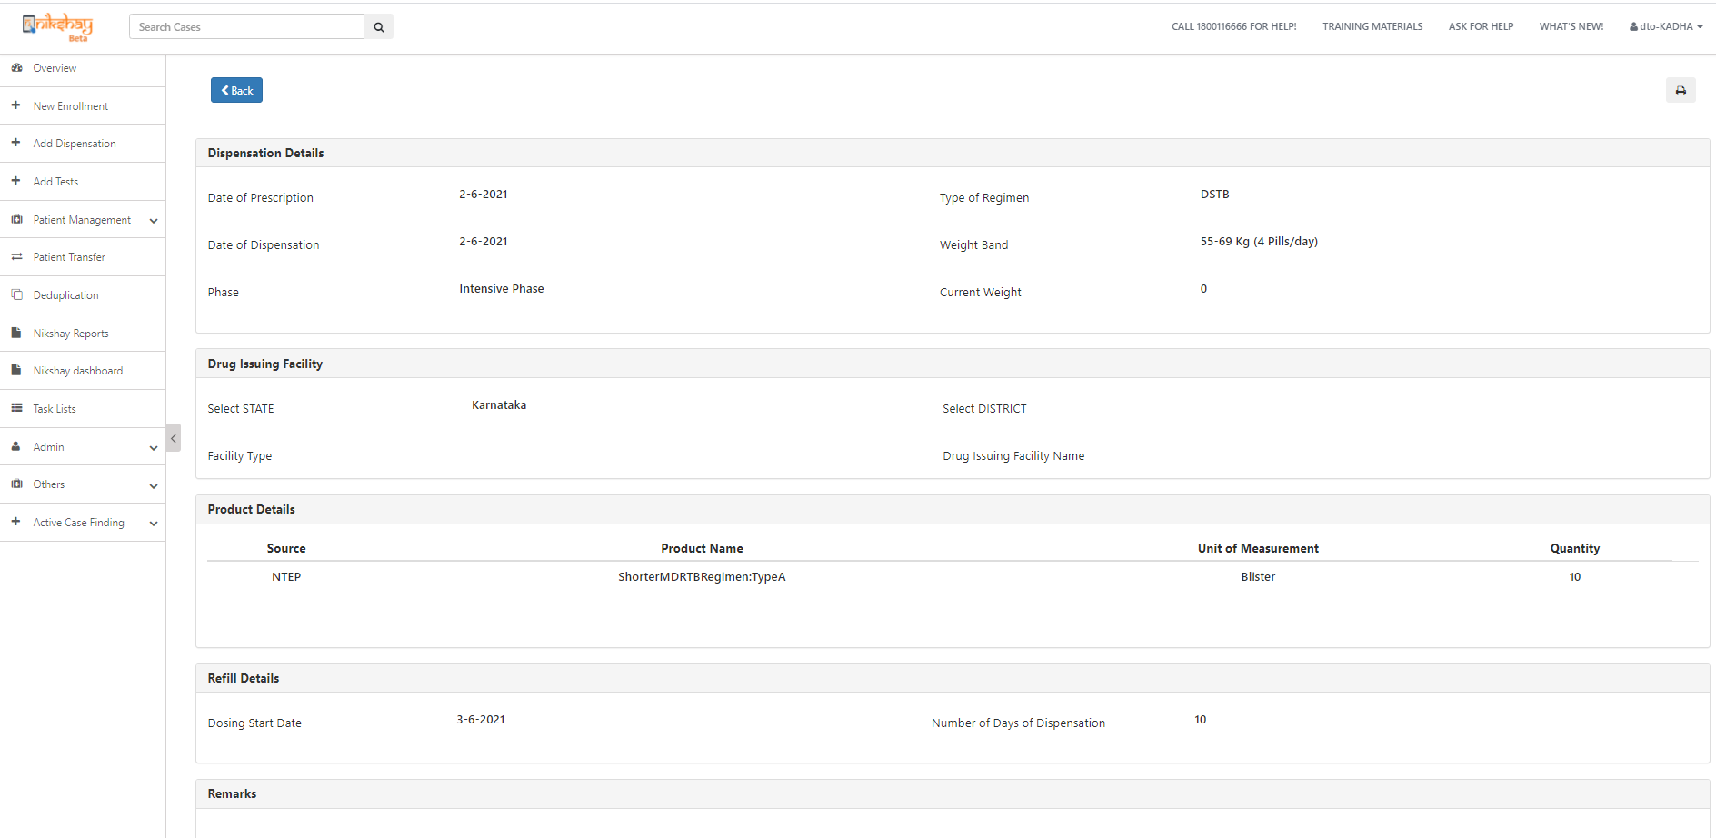
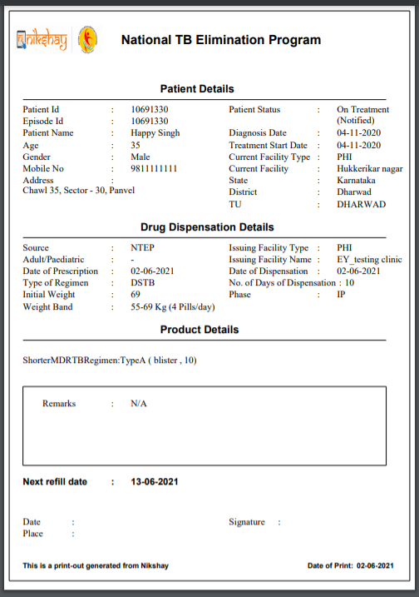
Print Dispensation Details
Print Preview
Click here to go back to the list of the dispensation
Click here to print a copy of the dispensation

Slide 18
Return Dispensation
Dispensation details can be viewed/added by entering the Episode or Dispensation ID of the patients
Click here to return any of the prescribed medicines, if required

Slide 19
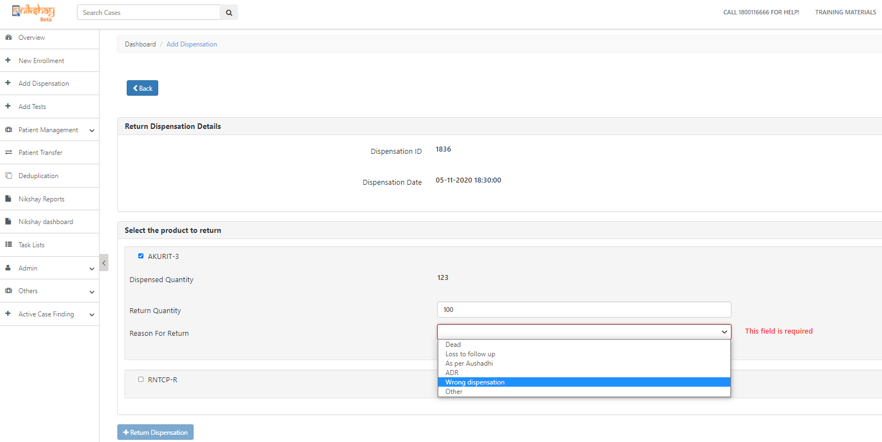
Return Dispensation
click here to go to list of dispensations
Return Dispensation Details
Enter the quantity of the medicines which is to be returned
Select a reason of the return from the drop down options, a mandatory field for return dispensations
Click here to complete the return of the Dispensation
This message pops up after successful return of a dispensation

Slide 20
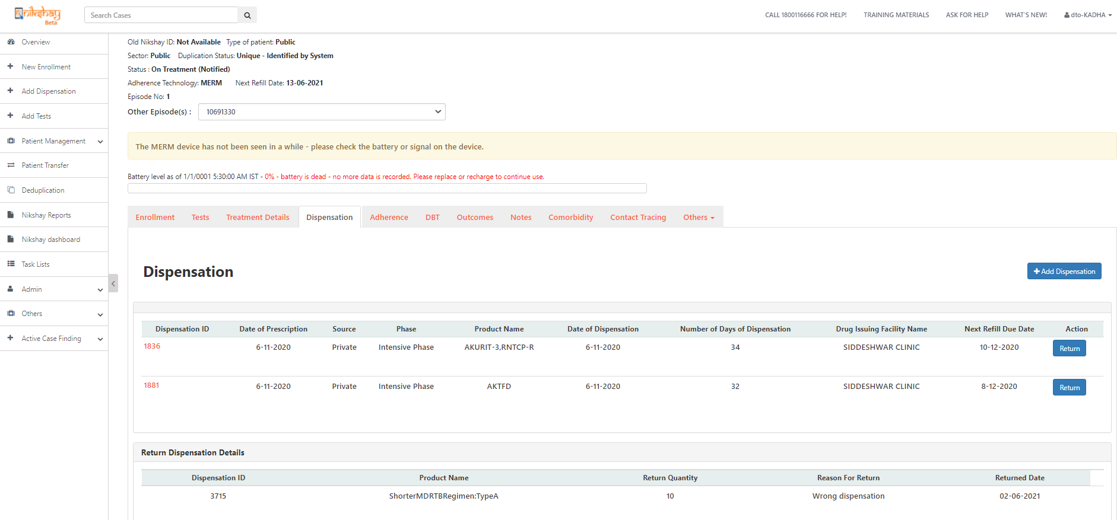
Return Dispensation
History of return dispensation can be seen under patient’s page , which can be navigated through patient’s name or the patient’s ID from Patient management or direct from the Search cases
Details of Returned Dispensations

Slide 21
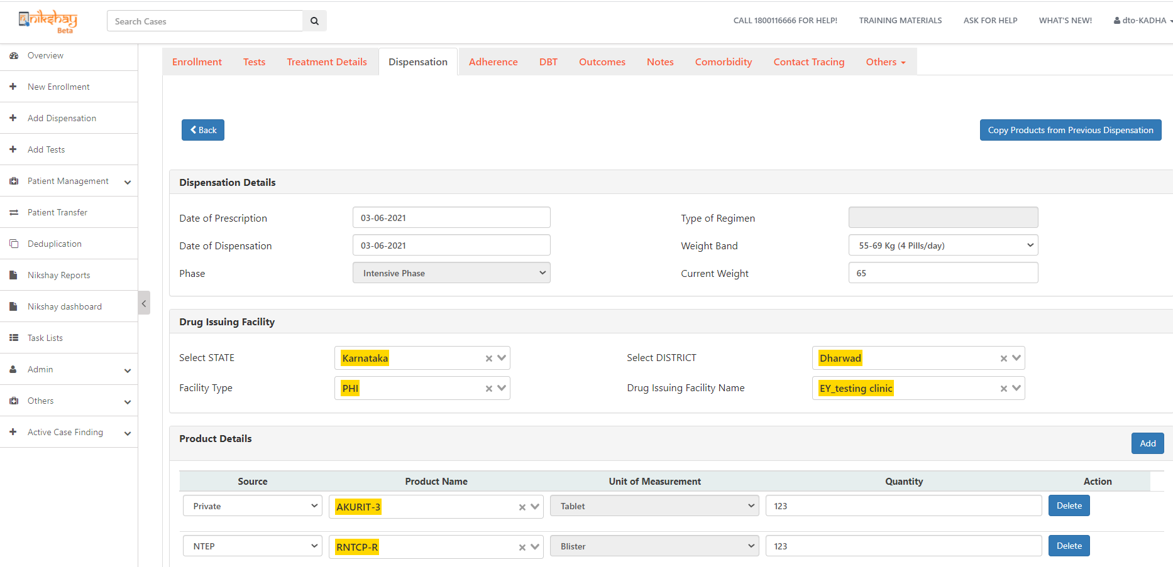
Copy products from previous Dispensation
Click here to copy medicine / products from the previous Dispensation,
this facility is available from the second dispensation record
Product details are getting copied from the previous dispensation including source, product name and quantities

Slide 22
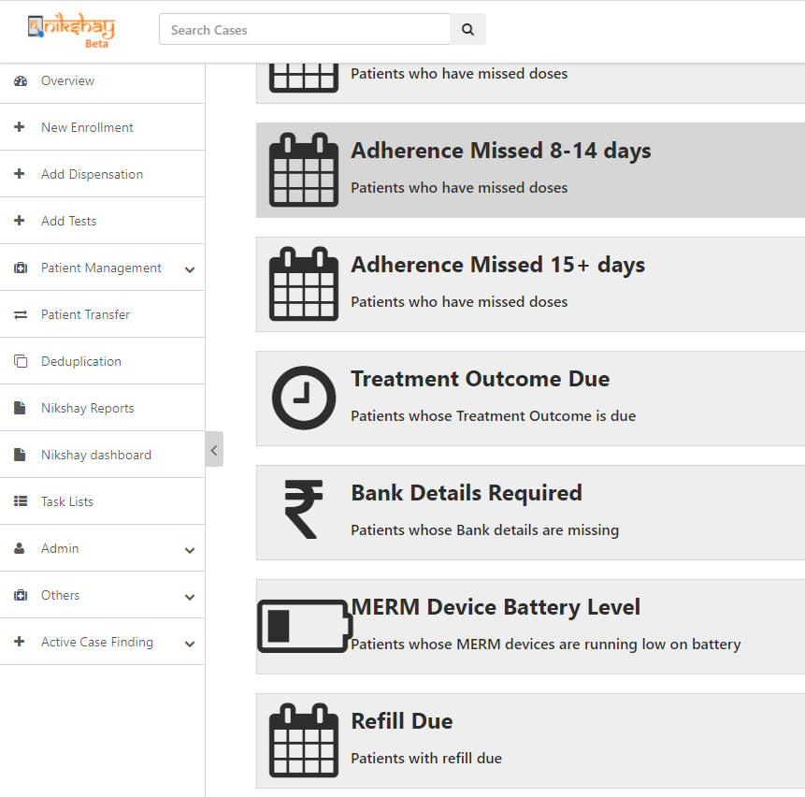
Refill Due Tasklist
The Next Refill Due Date is calculated based on the number of days for which Dispensation is Issued.
Click here to view the list of patients for whom refill is due.

Slide 23
Refill Due Tasklist
If patients have no dispensation details entered, their Date of Diagnosis will be considered as the default ‘Next Refill Date ’
Patient record enters the task list 2 days before their ‘Next Refill Date’.
The patient remains in the task list until his dispensation details are updated.

Slide 24
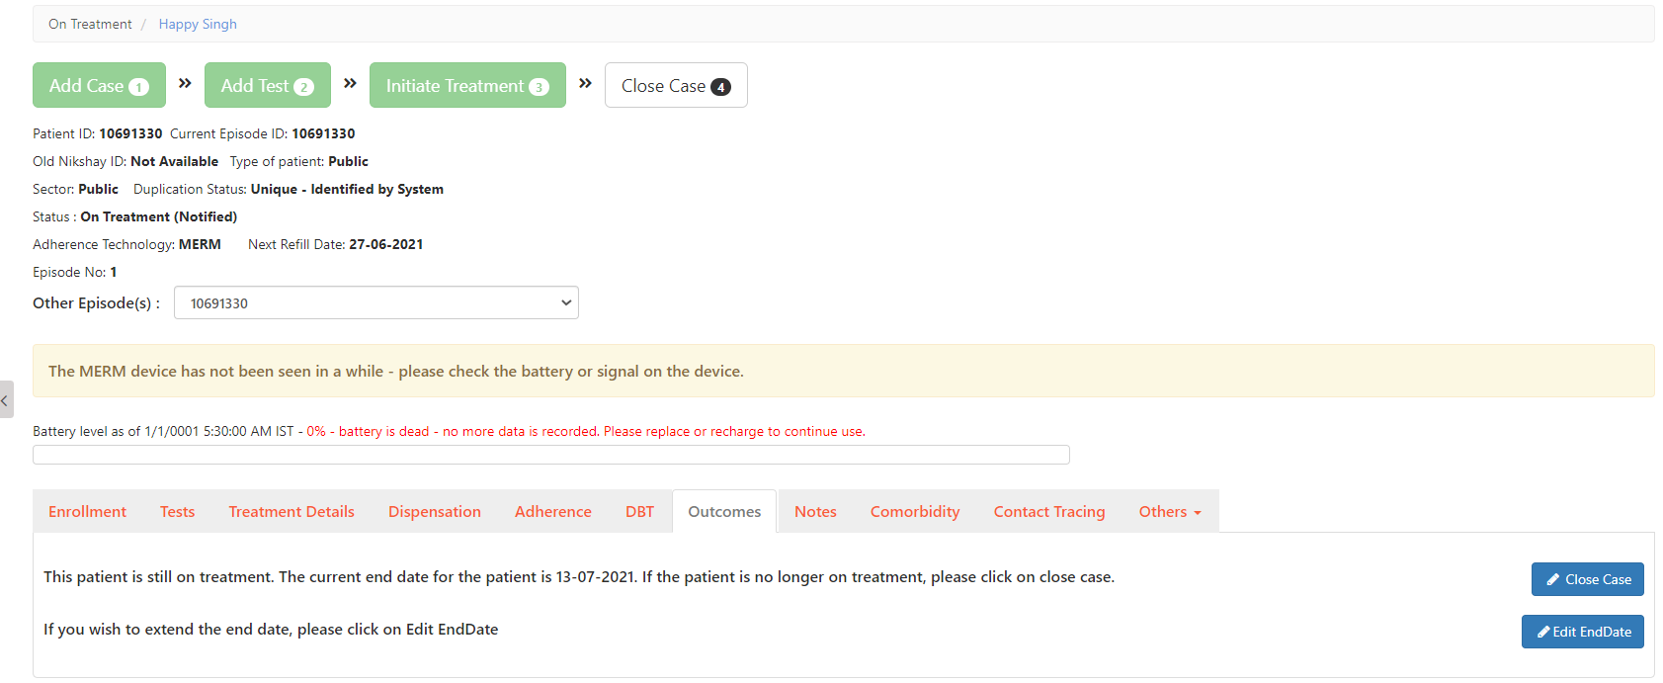
Outcome assignment changes
In the cases where the “Next Refill Due Date” is greater than the treatment end date, the “Treatment End date” is extended.

Slide 25
Outcome assignment changes
Patient Notes also get added with the changes made in the outcome end date I.e. it got extended from 4/20/2021 to 7/13/2021 based on the entry made against the patient ID
Notes:
Note: Patient’s End Date will be increased if the refill due date for the added Dispensation is greater than End date for the patient. If the Patients End date is increased due to a Dispensation there is also a corresponding Note for the same.

Slide 26
Outcome Validations (DSTB Patients)
Outcome Validations have been introduced as a part of this module.
1. To assign a ‘Treatment Complete’ outcome, the following conditions have to be met
Minimum of 168 Dispensed doses
168 manual or digital doses
2. To assign a ‘Cured’ outcome, the following conditions have to be met
Minimum of 168 Dispensed Doses
168 manual or digital doses
The follow up CP Test should be negative
The case should have been microbiologically confirmed.
The outcome validations listed above are applicable for DSTB Patients and the validations for DRTB Patients would be added subsequently.

Slide 27
Adherence and Dispensation Correlation
Adherence and Dispensation Correlation is defaulted as ‘Yes’ for all notified DSTB Patients and defaulted to ‘No’ for all notified DRTB Patients, but this can be manually turned On/Off by the staff through the ‘Treatment Details Tab’
If Adherence and Dispensation Correlation is selected as ‘Yes’ then staff will be unable to mark manual doses if an active dispensation is not available for the days on which manual doses are being marked.
If Adherence-Dispensation is selected as ‘No’ then staff will be able to mark manual doses irrespective of whether dispensation details are available or not.

Slide 28
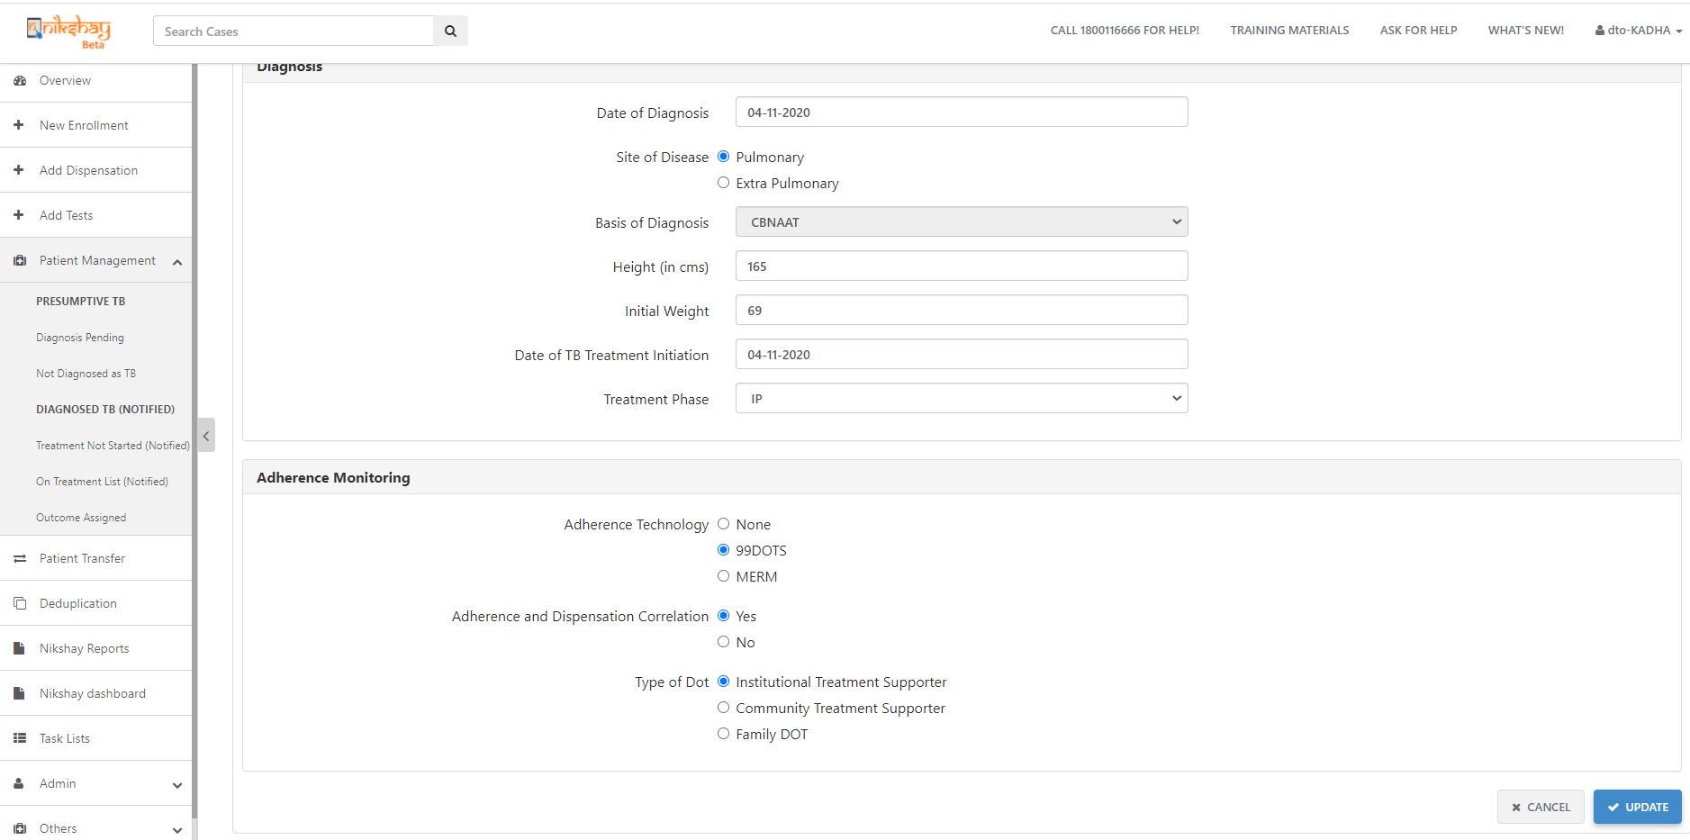
Adherence and Dispensation Correlation
1. Go to Treatment Details>Adherence Monitoring
2. Click on “Yes” in order to enable the “Adherence and Dispensation Correlation” feature. And, once it is marked as “Yes”, it shall not allow manual doses to be marked unless there is an active dispensation
3. Click on Update to save the revised settings

Slide 29
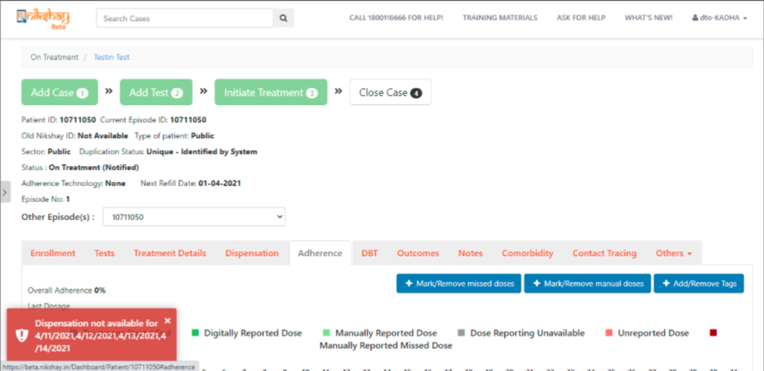
Adherence and Dispensation Correlation
If Adherence and Dispensation Correlation is marked as ‘Yes’ and if manual doses are added if no active dispensation details are available for those dates, then the user will be unable to add manual doses and an error message will be displayed.

Slide 30
Dispensation Register and Report
The below report and register is created for the Dispensation module-
Dispensation Patient wise register- This report contains the details of the product dispensed (Batch number, expiry date) added to the Patient wise dispensation register
Dispensation Consumption report- This is an Aggregate reporting of drug consumption levels, including opening stock and consumption. If the report is downloaded for the current month/ quarter then the current stock at PHI is displayed in the report

Slide 31
Dispensation Patient wise register

Slide 32
Dispensation Consumption report
If the report is downloaded for the current month/ quarter then the current stock at PHI is displayed in the report

Slide 33
Dispensation Consumption report
If the report is downloaded for the past month/ quarter then the current stock at PHI is not displayed in the report

Slide 34
Q1. Where can the user view the stock of all the medicines at their facility (District, TU, and PHI) without open patient’s profile. The stock can be viewed only by the Aushadhi team by using the stock search API. A report would also be made available in Ni-kshay portal on stock and consumption. Q2. How to distribute medicines on the portal from District to TU and TU to PHI? The stock management up to TU level including transfer to PHI would be handled by Aushadhi software, while PHI to patient would be handled by Ni-kshay. Q3. Can we dispense drugs to patients outside the logged in hierarchy? The drugs can be dispensed to patients belonging to any hierarchy even if the patient belongs to a hierarchy other than the logged in hierarchy. The dispensation can be done through the ‘Add dispensation’ module in Ni-kshay.
FAQs..1

Slide 35
Q4. The drugs transferred from TB unit to PHI are not visible in dispensation module PHI stock. The Drugs transferred from TBU to PHI would be visible in the Ni-kshay Aushadhi system. The transfer of drugs from TU to PHI would happen using the stock credit API. A report would be made available in Ni-kshay portal on the PHI stock and consumption. Q5. What is the process of consumption of CBNAAT and Truenat Cartridges, with inactivation of PHI login? Ni-kshay Aushadhi would reopen the PHI Module only for NAAT stores. The CBNAAT and TrueNat consumables would be reported in the NAAT consumable module of Ni-kshay Aushadhi.
Q6. Box preparation of Modified regimen of AOL regimen is not available in Ni-kshay aushadhi. Ni-kshayAushadi team to convert the existing stock of DRTB boxes into loose drugs and the stock to be updated on the system. The updated stock would then be consumed by Ni-kshay using API and available for users to dispense.
FAQs..2

Slide 36
Q4. Districts are not able to view PHI drug stock as a whole, It can only be viewed while dispensing to every patient. Which makes it difficult to assess the requirement of PHI Since Ni-kshay is handling the dispensation of drugs from PHI to patient, the available quantity of a particular product will be available only while dispensing the product. A report would be made available in Ni-kshay portal on the PHI stock and consumption that can be used to check the stock levels of the products. Q5. Dispensation module is not allowing to directly dispense drugs of Continuation Phase. For patients whom drugs have already been issued from Ni-kshay aushadhi, if we issue drugs in back date the current drug stock of PHI is getting deducted leading to imbalance in stock. All the TB patients are registered in Ni-kshay and undergo Intensive and Continuous phases of treatment. The drugs can be dispensed from Ni-kshay for current or future dispensation date. For dispensing drugs for Continuous Phase for a patient currently on IP, follow the below steps- 1. In the Patient management module, go to Treatment details tab of the patient. 2. Click the ‘Update’ button to update the Treatment Phase to CP 3. Add the End of IP date as a back date or a future date. 4. Go to Dispensation tab of the patient, where the Phase would be changed to CP 5. Dispense the drugs for CP phase.
FAQs..3

Slide 37
Q6. Currently Drug can be dispensed for any no. of days with patient’s Id. The limit should be fixed to maximum 60 days. This would help in buffer stock management, monitoring and minimizing the retrieval/wastage. This requirement will be discussed with the ministry and upon approval, this can be added in the future changes for Dispensation module.
Q7. Users unable to dispense NTEP drugs from private chemist and private health facility. Private Health facilities and chemists which are presently registered as third-parties will be registered as Health facilities in Ni-kshay Aushadhi and the NTEP drug stock will be updated for the same. Ni-kshay will consume the stock status of these facilities from Ni-kshay Aushadhi and make it available to users for dispensation Q8. The district alert dashboards shows acknowledgement pending in Ni-kshay Aushadhi . How can phi acknowledge without login to PHI module? Ni-kshay Aushadhi will disable the feature of acknowledging the drugs from PHI module from backend
FAQs..4

Slide 38
Q9. How will the drugs be indented from PHI to TU? The PHIs would submit their drug request to their parent stores (TU) through Offline indenting i.e. via email, Phone, or any other method. On receipt of Offline Indent, the respective TU would release the drugs to the PHI through the TU login in Ni-kshay Aushadhi using : Dispatch without drug request” under Issue / Dispatch Module.
Q10. how to return drug from DRTB/ PHI to DDS/ TU? The return from PHI to TU would be handled by Ni-kshay Aushadhi using the backend stock debit API. Q10. Should the PHI dispense lab consumables like head covers, shoe covers etc through Patient login in Ni-kshay? The PHI dispense lab consumables like head covers, shoe covers etc should not be dispensed through Patient login in Ni-kshay . These products are for PHI use and should be consumed only at PHI level.
FAQs..5

Slide 39
Thank You!

